Slide 1
Wireless WAN, Man & Lan

Slide 2
Outline
What’s Wireless Networks ?
Classification of Wireless Networks
Wireless WAN Technology
Wireless MAN Technology
Wireless LAN Technology

Slide 3
What’s Wireless Networks
Definition
  Refer to technology that enable two or more computer to communicate using standard network protocols, but without network cabling.
  Any technology that does this could be called wireless networking.

Slide 4
Classification of Wireless Networks
WWAN - Wireless Wide Area Network
  IEEE 802.20 (proposed)
WMAN - Wireless Metropolitan Area Network
  IEEE 802.16
  ESTI HiperMAN & HiperAccess
WLAN - Wireless Local Area Network
  IEEE 802.11
  ESTI HiperLan
WPAN – Wireless Personal Area Network
  (Not Present here)

Slide 5
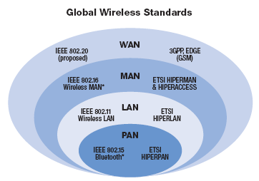
Wireless Networks

Slide 6
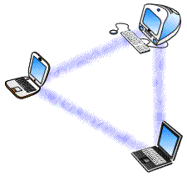
Two Kind of Wireless Networks
Ad hoc networks (non-infrastructure)
  Each computer with a wireless interface can communicate directly with all of the others.
[ Figure: Ad hoc Network ]

Slide 7
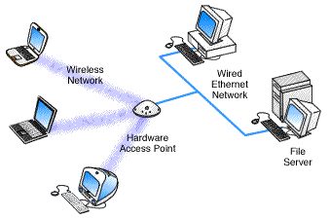
Two Kind of Wireless Networks
Infrastructure Network
  Use an access point, or base station to communicate with each other.
[ Figure: Infrastructure Network ]

Slide 8
OutLine of Wireless WAN
What’s Wireless WAN ?
IEEE 802.20
  Proposed

Slide 9
What’s Wireless WAN ?
WWAN ( Wireless Wide Area Network)
Refer to transmission range that can stride across many cities or countries.
Of course, it should be wireless.
  Ex: GSM

Slide 10
IEEE 802.20 (Proposed)
Work in licensed frequency bands below 3.5GHz
Peak data rates per user in excess of 1 Mbps
Cover cell size commensurate with ubiquitous metropolitan-area networks

Slide 11
OutLine of Wireless MAN
What’s Wireless Man ?
Introduction
IEEE 802.16
  IEEE 802.16 Standards
  Specification of IEEE 802.16
  Physical Layer
  Mac Layer
  Qos
ESTI
  HiperMan
  HiperAccess

Slide 12
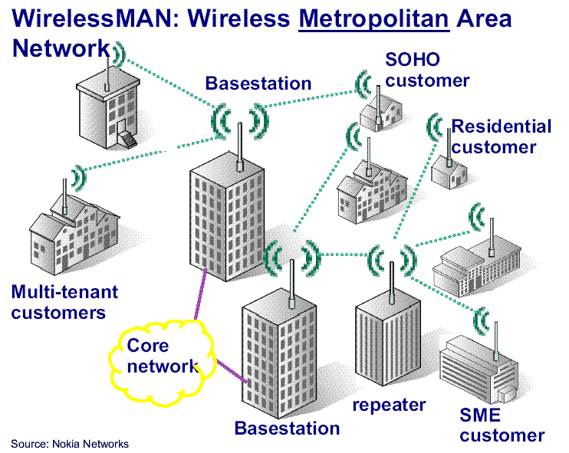
What’s Wireless MAN ?
Notes:
利用 Base Station 連接 Core Network，其餘的 Customer 都是 Subscriber Station，可以經由 Base Station 進行連線以及傳輸，其範圍可以涵蓋整個城市。

Slide 13
Introduction
Goal
  Provide high-speed internet access to home and business subscribers, without wire.
Base stations (BS) can handle thousands of subscriber stations (SS)
Access control prevents collisions.

Slide 14
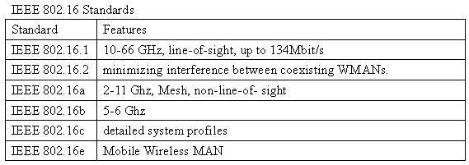
IEEE 802.16 Standards
Notes:
Line-of-sight: 指兩個傳輸點之間不可以有障礙物存在。
802.16.1：
使用 10-66 GHz 的頻段傳輸當中不能夠有任何的障礙物存在！
802.16a：
使用 2-11 GHz 的頻段，可以容許障礙物的存在。

Slide 15
IEEE 802.16 Specification
Consists of
  BS (Base Station)
  SSs (Subscriber Stations)
All data traffic goes through the BS
BS can control the allocation of bandwidth on the radio channel.

Slide 16
IEEE 802.16 Specification
SS
SS
BS
SS
Wireless Access Network
Notes:
Base Station 和 Subscriber Station 的示意圖，所有的 traffic 必須經過 Base Station。

Slide 17
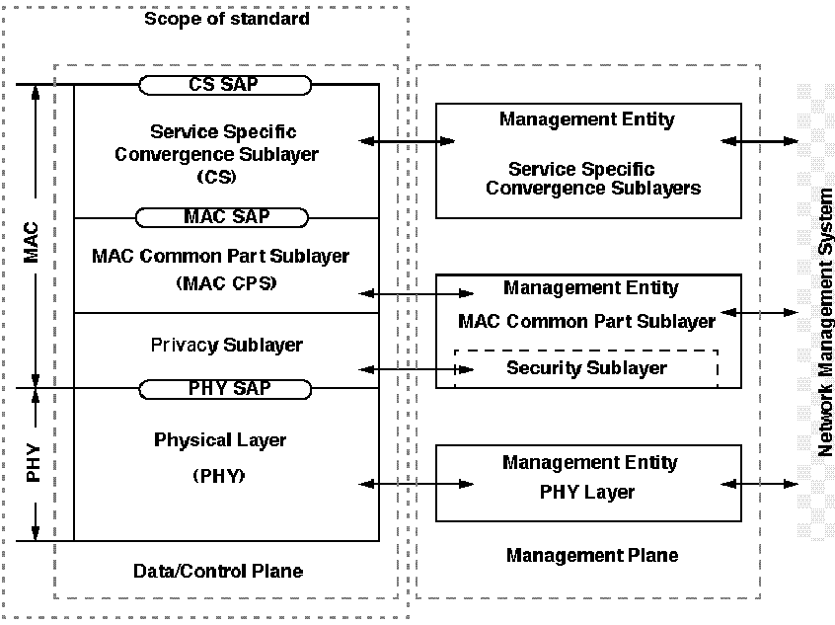
IEEE 802.16 Architecture
Notes:
IEEE 802.16 的規格主要在定義 Physical Layer 和 Mac Layer 的規格。
每個 Layer 間有 SAP 提供上層的規格作存取。
另外也提供了 Management 的 Plane，對各層的 Service 做管理！

Slide 18
IEEE 802.16 Specification
Scope :
  The air interface
  MAC (Medium Access Control)
  PHY (Physical layer)
Purpose :
  to enable rapid worldwide deployment of cost-effective broadband wireless access products
  to facilitate competition in broadband access by providing alternatives to wireline broadband access
Main advantage :
  fast deployment
  dynamic sharing of radio resources
  low cost

Slide 19
IEEE 802.16 Specification
The spectrum to be used
  10 - 66 GHz licensed band
    Due to the short wavelength
      Line of sight is required
    Channels 25 or 28 MHz wide are typical
    Raw data rates in excess of 120 Mbps
  2 -11 GHz
    IEEE Standards Association Project P802.16a
    Approved as an IEEE standard on Jan 29, 2003

Slide 20
IEEE 802.16 Features
Broadband wireless access (BWA)
  Fixed BWA systems
  Wireless metropolitan area networks (MANs)
Air interface for fixed BWA systems
  Spectrum on 10-66 GHz
  Common MAC definition
  Multiple PHY definitions, with baseline PHY supporting operation in 10-66 GHz
  Point-to-multipoint (PMP) operation
  Data Rate is 2 to 155 Mbps
  Must be line-of-sight

Slide 21
IEEE 802.16a Features
2-11 GHz licensed bands
  6 MHz bandwidth
  Point-to-multipoint BWA system

Slide 22
IEEE 802.16b Features
Unlicense Bands, 5-6 GHz
  20 MHz bandwidth
  Low power specification
  Wireless High-Speed Unlicensed Metropolitan Area Networks (WirelessHUMAN)
  OFDM and Adaptive Modulation QAM

Slide 23
Physical Layer
Allows use of directional antennas
Allows use of two different duplexing schemes:
  Frequency Division Duplexing (FDD)
  Time Division Duplexing (TDD)
Support for both full and half duplex stations

Slide 24
Physical layer
Adaptive Data Burst Profiles
  Transmission parameters can be modified on a frame-by-frame basis for each SS.
    Example
      Modulation
      FEC settings
  Profiles are identified by ”Interval Usage Code”
    DIUC: Downlink Interval Usage Code
    UIUC: Uplink Interval Usage Code
Notes:
在 IEEE 802.16 的規格當中，Subscriber Station 可以定義每一個 frame 的傳輸方式，例如：調變方式或者 FEC 的設定。
而經由 Interval Usage Code (IUC) 可以定義出 DIUC 和 UIUC 對每一個上傳或者下傳的 frame 的傳輸方式。

Slide 25
Physical layer
Using both
  TDM (Time Division Multiplexing) and
  TDMA (Time Division Multiple Access)
TDM
TDMA

Slide 26
Mac Layer
Connection orienteded
  Connection ID (CID)
  Service Flows (FS)
Channel access:
  UL-MAP
    Defines uplink channel access
    Defines uplink data burst profiles
  DL-MAP
    Defines downlink data burst profiles
  UL-MAP and DL-MAP are both transmitted in the beginning of each downlink subframe (FDD and TDD).
Notes:
CID: 每一個無線的連線將會配置一個而且唯一連線的 ID 作為識別。
FS: 一個提供某些 QoS 的連線，並且由 SFID (Service flow ID) 作為識別。
而上傳和下傳的方式由 UL-MAP 以及 DL-MAP 來做設定，而在每一個 subframe 的開頭就可以讀取該 frame 的 data burst profile。

Slide 27
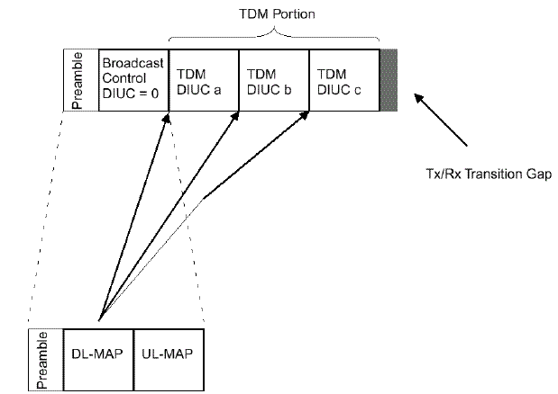
Mac Layer
Notes:
利用 Time Division 的方式所分割出的時槽可供給不同的 frame 做使用傳輸使用，因應每個 frame 的 DIUC 不同所傳輸的方式也不相同。

Slide 28
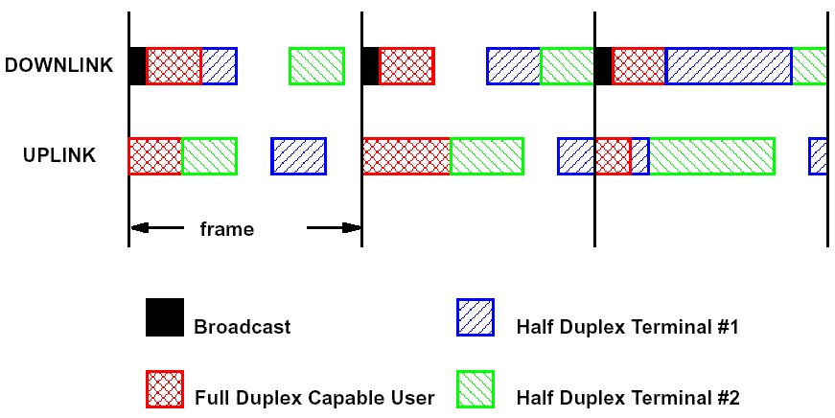
Mac Layer
Notes:
因為 IEEE 802.16 Burst Time Division 的方式，可以設定每一個 frame 的 burst profile 來進行個別的傳輸，因此不管在 downlink 或者是 uplink 都可以有彈性對不同的傳輸方式進行傳輸。

Slide 29
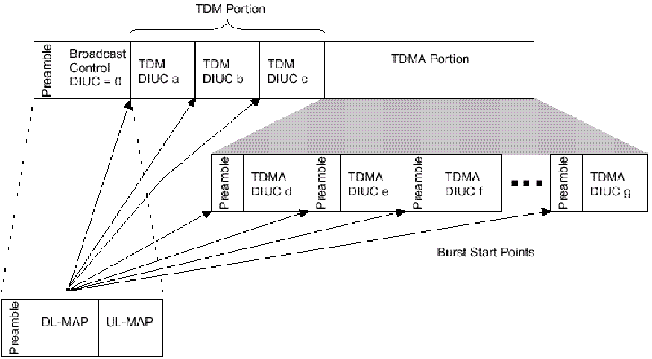
FDD Downlink subframe
Notes:
傳輸給某一些只支援半雙工的 Subscriber Station 會需要利用 preamble 來做 re-sync 的工作，因此分為 TDM （前頁已敘述）和 TDMA 兩部分。

Slide 30
Uplink periods
Initial Maintenance opportunities
  Ranging
  To determine network delay
  To request power or profile changes.
  Collisions may occur in this interval
Request opportunities
  SSs request bandwith in response to polling from BS.
  Collisions may occur in this interval aswell.
Data grants period
  SSs transmit data bursts in the intervals granted by the BS.
  Transition gaps between data intervals for synchronization purposes.

Slide 31
Bandwidth request and allocation
There are three ways for SSs request bandwidth:
  Use the ”contention request opportunities” interval upon being polled by the Base Station
    Multicast or broadcast poll
  Send a standalone MAC message called ”bandwidth request” in an already granted slot.
  Piggyback a bandwidth request message on a data packet.

Slide 32
Bandwidth request and allocation
There are two mode for BS grants/allocates bandwidth:
  Grant Per Subscriber Station (GPSS)
  Grant Per Connection (GPC)
Decision based on requested bandwidth and QoS requirements vs available resources.
Notes:
GPSS：
依據每一個 station 來進行頻寬的取得，overhead 較低。
GPC：
較適合用在每個 subscriber station 僅有較少的的使用者的情況下，因為每一個連線都要重新取得 bandwidth，所以會造成 overhead 過高。

Slide 33
Unicast Polling
BS allocates space for the SS in the uplink subframe.
SS uses the allocated space to send a bw request.
BS allocates the requested space for the SS (if available).
SS uses allocated space to send data.
BS
SS
Poll(UL-MAP)
Request
Alloc(UL-MAP)
Data

Slide 34
Four types of Scheduling Service
Unsolicited Grant Service (UGS)
  Real-time, periodic fixed size packets (e.g. T1 or VoIP)
  Restrictions on bandwidth requests (Poll-Me bit)
Real-Time Polling Service (rtPS)
  Real-time, periodic variable sizes packets (e.g MPEG)
  BS issues periodic unicast polls.
  Cannot use contention requests, but piggybacking is ok.
Notes:
UGS: 利用週期性固定大小的封包來做即時的傳輸，如：T1 或者 VoIP。
rtPS: 週期性但可變動的大小的封包來做及時的傳輸，Base Station 可以利用週期性的詢問，並且無法利用競爭的方式來取得，可利用 piggyback 的方式來做取得。

Slide 35
4 types of Scheduling Service
Non-Real-Time Polling Service (nrtPS)
  Variable sized packets with loose delay requirements (e.g. FTP)
  BS issues unicast polls regularly (not necessarily periodic).
  Can also use contention requests and piggybacking.
Best Effort Service
  Never polled individually
  Can use contention requests and piggybacking
Notes:
nrtPS: 對於 delay 較不敏感的服務，像是 FTP 。就可以利用 Base Station 去詢問或者 piggyback 的方式來做服務的取得。
BE: 可以利用競爭或者 piggyback 的方式來取得，目前的資源有多少，便可取得多少的資源來進行使用。

Slide 36
QoS mechanisms
Scheduling
  Downlink scheduling module
    Simple, all queues in BS
  Uplink scheduling module
    Queues are distributed among SSs.
    Queue states and QoS requirements are obtained through BW requests.
  Algorithms not defined in standard
Notes:
下傳的資料可以累積在 Base Station 裡面以方便之後的傳輸，但是上傳的資訊就必須分散在各 Subscriber Station 裡面，而 Queue 的狀態和 Qos 的需求經由 BW 的 request。
然而 802.16 的 QoS 的演算法目前還沒被定義為標準。

Slide 37
HiperMAN & HiperAccess
ETSI
  European Telecommunications Standards Institute
Bran (Broadband Radio Access Network)
  HiperAccess
  HiperMan
Notes:
High Performance Radio Access (HIPERACCESS) is an interoperable standard tailored to give broadband access to both the home and small- and medium-sized enterprises, as well as to provide backhaul for mobile systems (e.g. W-CDMA, CDMA2000, GSM and GPRS). The ETSI Project Broadband Radio Access Networks (EP BRAN) working on the standard agreed the core technical specifications (i.e. the specifications for the Physical (PHY) Layer and for the Data Link Control (DLC) Layer) in early 2002, and is in the process of developing the convergence layer for support of different core networks, such as Internet Protocol (IP), Ethernet and Asynchronous Transfer Mode (ATM).
The HIPERACCESS standard was developed to provide a truly broadband system with bit rates of up to approximately 100 Mbit/s, although 25Mbit/sec is expected to be the most widely deployed rate. HIPERACCESS is targeted at high frequency bands, especially for the 40,5 - 43,5 GHz band. For these frequency bands TDMA will be used to provide multiple access.
High Performance Radio Metropolitan Area Network (HIPERMAN) is aimed at providing a broadband wireless solution for Metropolitan Area Networks. HIPERMAN will be an interoperable broadband fixed wireless access system operating at radio frequencies between 2 GHz and 11 GHz. The air interface will be optimized for Point-to-MultiPoint (PMP) configurations, but allows for flexible mesh network deployments as well. HIPERACCESS and HIPERMAN address the same markets but have been separated as the higher frequencies used in HIPERACCESS require different techniques to the lower frequencies used by HIPERMAN to deliver the required QoS and other system metrics.
HIPERACCESS and HIPERMAN are related to the WirelessLAN technology HIPERLAN2, but they are differentiated by the need to address issues such as propagation delay mitigation and delay spread tolerance, that the HIPERLAN2 with its smaller range does not have to address. The HIPERLAN2 WirelessLAN system and the use of Xilinx devices in WirelessLAN systems is discussed in more detail in the Wireless LAN presentation.
The HIPERACCESS/HIPERMAN and WirelessMAN standardization efforts are expected to provide a large impetus to the fixed wireless equipment market. The presentation addresses the use of Xilinx devices in such systems and looks at how they help deliver such products rapidly to market. Click to view the IEEE802.16 WirelessMAN Solutions presentation.

Slide 38
HiperMAN
< 11GHz carriers
Doesn’t need Line Of Sight, up to 15 miles range
10 – 25 Mbps data rate, using OFDM
Harmonization efforts under way to have degree of compatibility with IEEE 802.16
Notes:
OFDM
Frequency division multiplexing (FDM) is a technology that transmits multiple signals simultaneously over a single transmission path, such as a cable or wireless system. Each signal travels within its own unique frequency range (carrier), which is modulated by the data (text, voice, video, etc.).
Orthogonal FDM's (OFDM) spread spectrum technique distributes the data over a large number of carriers that are spaced apart at precise frequencies. This spacing provides the "orthogonality" in this technique which prevents the demodulators from seeing frequencies other than their own. The benefits of OFDM are high spectral efficiency, resiliency to RF interference, and lower multi-path distortion. This is useful because in a typical terrestrial broadcasting scenario there are multipath-channels (i.e. the transmitted signal arrives at the receiver using various paths of different length). Since multiple versions of the signal interfere with each other (inter symbol interference (ISI)) it becomes very hard to extract the original information.
OFDM is sometimes called multi-carrier or discrete multi-tone modulation. It is the modulation technique used for digital TV in Europe, Japan and Australia.
Uses
DAB - OFDM forms the basis for the Digital Audio Broadcasting (DAB) standard in the European market.
ADSL - OFDM forms the basis for the global ADSL (asymmetric digital subscriber line) standard.
Wireless Local Area Networks - development is ongoing for wireless point-to-point and point-to-multipoint configurations using OFDM technology.
In a supplement to the IEEE 802.11 standard, the IEEE 802.11 working group published IEEE 802.11a, which outlines the use of OFDM in the 5.8-GHz band.

Slide 39
HiperAccess
Outdoor
Support Wireless connection to wire equipment
> 11 GHz carriers
Line of Sight connections, up to 5 miles range
25 – 60 Mbps data rates, using single carriers
Compatibility with IEEE 802.16

Slide 40
HiperAccess Standard
Support of frequency allocations
  Frequency Division Duplex (FDD)
  Time Division Duplex (TDD)
Main application is cellular backhauling
co-operating with IEEE-SA (WG 802.16)
  to harmonize the interoperability standards for broadband multimedia fixed wireless access networks.
Notes:
HiperAcess 主要是利用 FDD 和 TDD 來做傳輸，最主要是可以做 WLAN Switch 到普通使用者的 AP 的連線（稱做 backhauling)，提供了無線網路較長距的連接。
並且可以與 IEEE 802.16 共存，並且相互合作。

Slide 41
Outline of Wireless Lan
What’s Wireless Lan ?
Spread Spectrum Technology
  FHSS
  DSSS
  OFDM
IEEE 802.11
  Introduction
  IEEE 802.11/a/b/g
  IEEE 802.11e
  IEEE 802.11f

Slide 42
Outline of Wireless Lan
HiperLan
  Introduction
  HiperLan/1/2
  HiperLink

Slide 43
What’s Wireless Lan ?
WLAN (Wireless Local Area Networks)
Refer to transmission range that stride across about 100 meters
Usually use in an office or a building

Slide 44
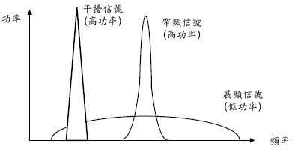
Narrow Band Spectrum
High power signal
  Narrow band channel
  More high power, larger guard band needed
  To ensure signal transmission correctly
Notes:
Guard band 的主要功能是要區隔每一個 channel 的互相影響，因為窄頻通訊的特色就是功率高，功率高的情況會造成相互影響的情況也就越大，所以需要較大的 guard band 來做區隔。而高功率的好處為容易被辨識而被正確接收。

Slide 45
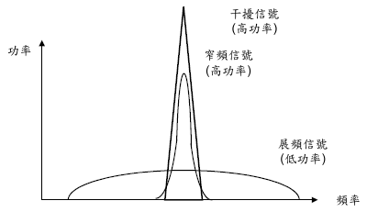
Narrow Band Spectrum
Jam problem
Notes:
當然高功率的情況遇見另一個更高功率的同頻訊號產生時，就會有蓋台的現象產生。所謂的蓋台也就是無法接受到原來的訊息，而被較高功率的訊息所取代。

Slide 46
Spread Spectrum Technology
High power -> Low power signal
Low power signal will be think to noise
  Better for security
Good for Anti-jamming
Notes:
所以展頻因而產生了，將高功率的訊號轉換成低功率的訊號再進行傳輸，因為低功率的訊號叫接近雜訊，所以較不容易被攔截到所以有較好的安全性。

Slide 47
Spread Spectrum – DSSS
DSSS (Direct Sequence Spread Spectrum)
22 MHz per channel
Chipping code or Processing Gain
  Lager Processing Gain
    Better Anti-Jamming ability

Slide 48
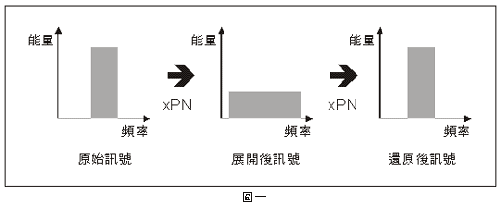
Spread Spectrum – DSSS
Original signal spread from high power to low power, echo signal spreading to many chips (according processing gain).
When destination receive spread spectrum, it regain the spread signal to original signal.

Slide 49
Spread Spectrum – FHSS
FHSS (Frequency Hopping Spread Spectrum)
Data signal multiplied by Pseudo Random Noise Code
  Dwell Time
    Longer dwell time will increase throughput
    Short dwell time will increase Anti-jamming ability
Notes:
利用不同的 Pseudo Random Noise Code 進行跳頻，可以同時進行傳輸而不被影響。
而 Dwell Time 是只跳頻之後的停留時間，停留時間越長所產生的 throughput 越增加，而相對的如果停留時間越短，跳頻越頻繁則被干擾的情況越不明顯。

Slide 50
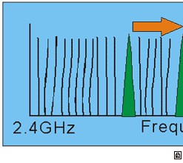
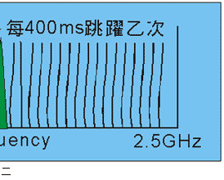
Spread Spectrum – FHSS
Transmission channel will change when dwell time is finished.
Then hop to another channel to continuously transmit.
The dwell time example above is 400 ms.

Slide 51
Spread Spectrum – OFDM
OFDM (Orthogonal Frequency Division Multiplexing)
Advantage
  Save bandwidth
  Solve multipath problem
  Anti-jamming from narrow band spectrum
    FEC (Forward Error Correction)
Notes:
因為正交的電波不會相互的影響，故不需要 guard band 之外，部分頻寬還可以重疊利用，故可以有效的節省了頻寬。
也因為正交的特性，在多路徑的的影響下仍不受干擾，而同為展頻技術的 OFDM 對抗蓋台干擾的能力依然很強。

Slide 52
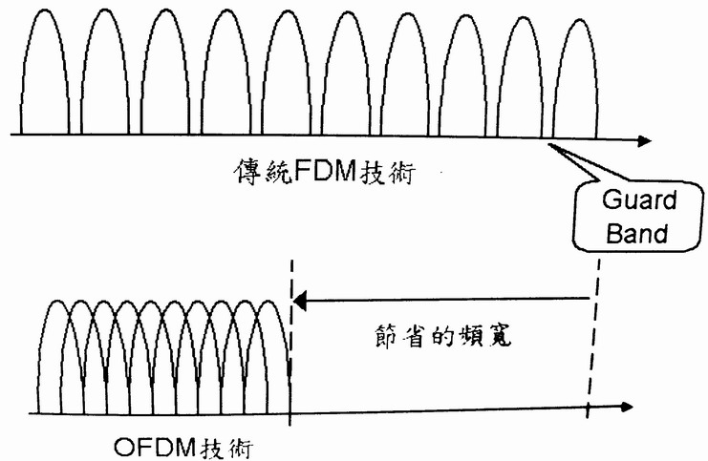
Spread Spectrum – OFDM
Notes:
傳統的 FDM 需要 guard band 的間隔以避免相互的干擾，而 OFDM 可以利用電波正交而不相影響可節省更多的頻寬。

Slide 53
IEEE 802.11 Logical Architecture
Application
Presentation
LLC (802.2)
Session
MAC
Transport
Network
PHY
Data link
Physical
Notes:
IEEE 802.11 的規格主要是制訂 Physical 和 Mac 兩層的的規格（不包含 LLC）。

Slide 54
IEEE 802.11 Sublayers
Higher layers
802.11c
802.11F
802.11d
802.11e
802.11h
802.11i
MAC
PHY
802.11a
802.11b
802.11g
Notes:
一些 802.11 的規格是訂立於某些 layer 的規格，譬如 IEEE 802.11/a/b/g 三樣規格就是主要訂立於實體層的規格定義。
而 IEEE 802.11e QoS 和 802.11i 認證機制就是建立在 Mac layer 上面的規格及協定。

Slide 55
Origin IEEE 802.11
Spectrum
  2.4 G
Transmission Range
  2Mbps/250M
Radius of transmission range
  DSSS: 100M
  FHSS: 50M

Slide 56
IEEE 802.11b
IEEE 802.11HR (High Rate)
DSSS + CCK (Complement Code Keying)
  Transmission Rate：11Mbps
  Radius of transmission range：100M above

Slide 57
IEEE 802.11a
Spectrum：5 G
Transmission Rate ：54Mbps
Radius of transmission range ：about 100M
Lack of compatibility

Slide 58
IEEE 802.11g
Release on 2003
Spectrum ：2.4 G
Transmission Rate：54Mbps
Radius of transmission range ：about 100M
Compatible with 802.11b
The same Transmission Rate as 802.11a

Slide 59
Future Specification IEEE 802.11n ?
Transmission rate will increase to 100 Mbps above
Two choices:
  WWiSE
    2x2 antenna, 20 MHz
    135 Mbps
  TGn Sync
    2x2 antenna, 20 MHz
    108 Mbps

Slide 60
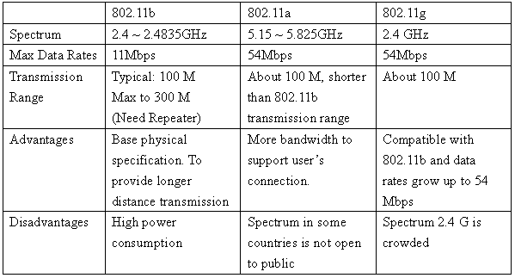
Comparison about IEEE

Slide 61
IEEE 802.11e
QoS (Quality of Service)
  Priority based
  To ensure quality when we transmit data and multiple media

Slide 62
Medium Access Control
DCF (Distributed Coordination Function)
  Contention-Based Medium Access Control
  CSMA/CA
PCF (Point Coordination Function)
  Contention Free Medium Access Control
  Optional access method works like polling
  Suited for Time Bound Services like Voice or Multimedia
Notes:
DCF 以競爭為基礎的 Medium Access Control，利用 Collision Avoidance 來做傳輸。
PCF 與 PCF 相反，使用類似 polling 的方式來做 Medium Access Control，比較適合有時間限制的服務，像是多媒體或者聲音的傳輸。

Slide 63
Medium Access Control
Carrier Sensing
  Physical carrier sensing
    Sense the medium (physical channel)
  Virtual carrier sensing
    Set Network Allocation Vector (NAV) to the duration field value in the data, RTS or CTS frame
    NAV indicates the amount of time elapsed until the current transmission completes
Notes:
Carrier Sensing 可以分為兩種：
其一是直接利用感測實體層的方式。
另外一種則是利用 NAV 來記錄 RTS 或 CTS Frame 內的 duration field
於是 NAV 內記錄的就是現在的傳輸到結束所需要的時間。

Slide 64
Basic Transmission Algorithm
NAV=0?
No
Yes
Sense the medium
(perform physical channel
assessment)
No
Random
Backoff
Time
Medium
Idle?
Yes
Transmit Frame
Yes
Collision?
No

Slide 65
Medium Access and IFS
IFS (Inter-Frame Spacing)
SIFS: Short IFS
PIFS: PCF IFS = SIFS + slot time
DIFS: DCF IFS = SIFS + 2*slot time
DIFS
DIFS
PIFS
medium busy
SIFS
contention
next frame
Slot time
time
Notes:
IFS 就是每一個 frame 之間的最小間隔，而不同的 Medium Access 定義出不同的 IFS 。

Slide 66
Exponential Back-off
Exponential Back-off
  Random back-off time within a contention window [0, CW]
  Contention window size increases with retransmission
  Back-off time = random() * slot time
  Random() = a pseudo random integer in [0,CW]
  CWmin <= CW <= CWmax, CW starts with CWmin and increases by every retransmission up to CWmax, and is reset to Cwmin after successful transmission

Slide 67
DCF
Distributed Coordination Function
Listen before-talk scheme based on the CSMA
Stations transmits when medium is free for time greater than a DIFS period
Random backoff is issued when medium busy
  All backoff slots occur after a DIFS

Slide 68
DCF
DIFS
Src
Data
SIFS
Dest
Ack
DIFS
Contention Window
Others
Next MPDU
Defer Access
Backoff after Defer
Defer access based on Carrier Sense
Direct access when medium is sensed free longer then DIFS, otherwise defer and backoff.
Receiver of directed frames to return an ACK immediately when CRC correct

Slide 69
PCF
Point Coordination Function
Contention-free frame transfer
Single Point Coordinator (PC) controls access to the medium.
  AP acts as PC
PC transmits beacon packet when medium is free for time greater than PIFS
  PCF has higher priority than the DCF
During PCF mode,
  PC polls each station for data
  After a transmission of a MPDU, move on to the next station
  Ineffective on large networks
Notes:
PCF 不需要競爭，因為是使用 Single Point Coordinator (PC) 來做處理的，在 infrastructure mode 裡面，由 AP 來執行 PC 的動作。
PC 會在 medium 空了超過 PIFS 的時間之後發出一個信號彈 (beacon)，接著 PC 會 poll 訊號給所有的 Node，並且指定可以由那一個 node 來進行傳輸。
然而這樣子不需要競爭的方式是因為經由一個 Single Point 來做處理，所以在網路大的地方這樣子的方式反而很沒有效率。

Slide 70
PCF
PIFS
SIFS
SIFS
SIFS
PIFS
SIFS
SIFS
PC
Data+Poll
Data+Poll
Data+Poll
CF-End
Beacon
DATA+ACK
SIFS
(no response)
ACK
STA1
CP
Contention Free Period
CP
STA2
Station 2 sets NAV(Network Allocation Vector)
NAV
Reset
STA3
Station 3 is hidden to the PC, it does not set the NAV.
It continues to operate in DCF.
Time
Notes:
在一段 Contention Free 的時間啟動的時候 PC 就會丟出一個 beacon 告知 CFP 已經開始，並且時間為多久，而為了避免干擾，因此 PIFS 比 DIFS 還為短，如此一來 DCF 的競爭就不會有機會可以介入 PCF 的機制當中。當然也有可能出現 hidden station 的問題，將於下一張投影片說明。

Slide 71
Limitations of PCF
Unknown transmission time of the polled stations
  Delays the transmission of time-bounded traffic
  Unpredictable time delays in each CFP
Hidden station problem
  Could transmit interfering frames during CFP

Slide 72


Limitations of PCF
PC
PC
CF-Poll
Data
Data
Data
Collision
STA1
STA2
STA3
STA4
BSS1
BSS2
Notes:
有一些 Station 不為 PC 所見，譬如例子中的 STA3 並不為 BSS1 的 PC 所見，於是他進入 CFP 的程序之後，STA1 要傳送資訊給 STA2。
當他取得 PC 的許可之後，像 STA2 進行傳輸，而 STA3 仍在 DFS 的狀態，所以在競爭之後要傳輸 Data 給 STA2，於是就會產生 collision。

Slide 73
QoS Support Mechanism of 802.11e
Priority schemes
  Provides differentiated control of access to the medium with differing priorities (8 priority queues)
EDCF (Enhanced DCF) and HCF (Hybrid Coordination Function)
TXOP (Transmission Opportunity)
  An interval of time when a particular STA has the right to initiate transmissions
  Defined as an interval of time
    Define a starting time and a maximum duration
  Allocated via contention (EDCF-TXOP) or granted through HCF (polled-TXOP)
Notes:
What’s TXOP ?

Slide 74
EDCF
Enhanced Distributed Coordination Function
CSMA/CA and Exponential Backoff
Eight Traffic Categories (TCs) within one station

Slide 75
EDCF
High priority
Low priority
DCF
TC7
TC6
TC5
TC4
TC3
TC2
TC1
TC0
Backoff
(AIFS)
Backoff
(AIFS)
Backoff
(AIFS)
Backoff
(AIFS)
Backoff
(AIFS)
Backoff
(AIFS)
Backoff
(AIFS)
Backoff
(AIFS)
Backoff
(AIFS)
Scheduler
(resolve virtual collisions by granting permission to highest priority)
Transmission
attempt
Transmission
attempt
AIFS:Arbitration Inter-Frame Space
Notes:
EDCF 定義了八個 priority，並且利用 scheduler 來解決 Virtual collision。

Slide 76
IFS on TCs
AIFS(TC1)
AIFS(TC4)
Low
Priority TC
backoff
AIFS(TC7)
PIFS
Medium
Priority TC
backoff
SIFS
SIFS
Ack
High
Priority TC
RTS
DATA
CTS
time
Contention Window
(Counted in slots)
SIFS
Notes:
較高的 priority 有較短的 AIFS 以利於競爭。

Slide 77
HCF
Hybrid Coordination Function
During CFP
  Poll STAs and give a station the permission to access channel
  Starting time and maximum duration of each TXOP are
  specified by HC
During CP
  HC can issue polled TXOPs in the CP by sending CF-Poll after a PIFS idle period
  Controlled Contention
    Allows STAs to request the allocation of polled TXOPs
    STAs send resource request frames with the requested TC and TXOP duration
    HC sends an ACK for resource request to the STA
Notes:
Not yet

Slide 78
Controlled Contention
HC
① HC: sends control frame for CC
② Legacy: keep silent during CCI
③ STA sends resource request
❍ HC gives a permission to STA
CCI: Controlled Contention Interval
Notes:
Not yet

Slide 79
Summary of IEEE 802.11e
802.11
QoS support mechanism in 802.11e
  Priority Scheme
    8 Traffic Categories within one station
  EDCF/HCF
    Polling mechanism
    Controlled Contention

Slide 80
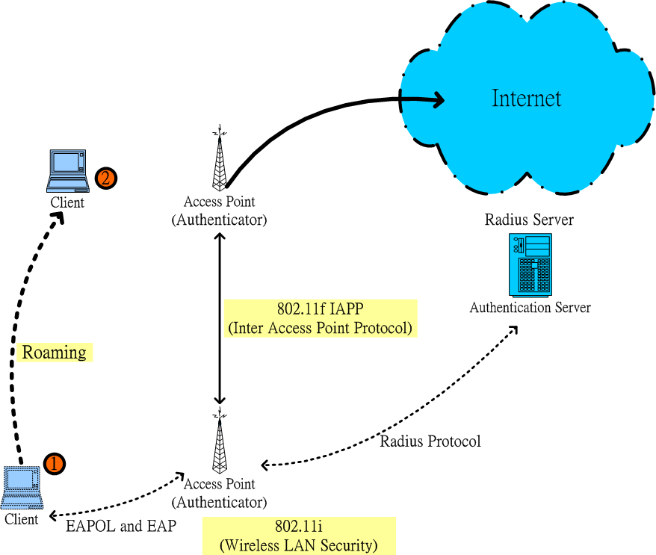
IEEE 802.11f
Notes:
利用 802.11f IAPP 的協定，可以從一台 AP 漫遊到另外一台 AP 而不會讓使用者額外設定。

Slide 81
IEEE 802.11f IAPP
IAPP (Inter-Access Point Protocol)
Roaming
  Handoff between different Access Points
  Can transmit continuously

Slide 82
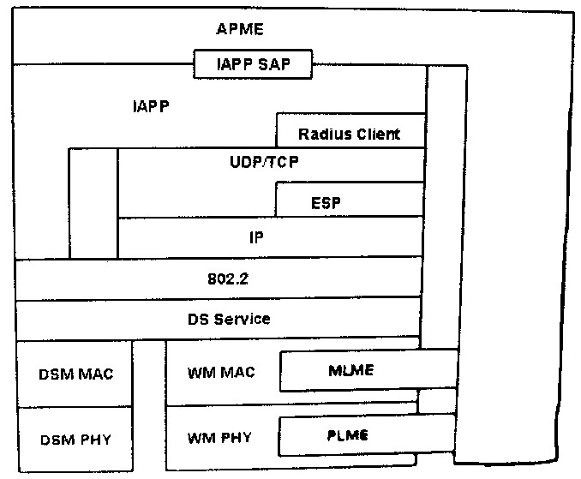
IAPP Architecture
Notes:
IAPP 協定在 TCP/UDP/IP 上面，並且透過 IAPP 的 SAP 可以對 AP 送出要求，而各元件的意義列茲如下頁！

Slide 83
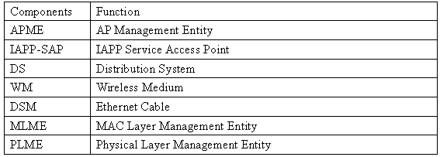
IAPP Architecture

Slide 84
IAPP Security Level
Three security level
  Non-Radius Server
    Set on per APs
    Fit in small networks
    Security Concern
  Radius Server
  Radius Server + secure connection

Slide 85
IAPP Command: Join
Join
  Client
    ADD-Request to IAPP Layer
    ADD-Notify to APs
  New charge AP
    ADD-Confirm
  Other APs
    ADD-Indicate
    Disassociate

Slide 86
IAPP Command: Move
Move
  Client
    Move-Request to IAPP
    MOVE-Notify to new AP
    Provide old AP’s Mac Address to new AP
    New AP will connect to old AP
    Transfer data in old AP to new AP
    Old AP clean the cache

Slide 87
IEEE 802.11f Last Version
Cache command
  Goal
    Reduce roaming switch time between AP to AP
  Action
    AP pre-send “associate data” to neighbor AP
    When client move to neighbor AP, client can smoothly re-associate to new AP

Slide 88
IEEE 802.11s
Open Question:
  How to tie communities and individuals without costly infrastructure?

Slide 89
Solution - Hotspots
Public Hotspots
  Require at least one Access Point to cover a small area, like a store or a building
  And there is also the need of a broadband connection to this location

Slide 90
Solution – Mesh Network
Mesh Network
  Very ad-hoc and the participate in the network are likely randomly distributed
  Does not require a connection to the internet to exchange data between members

Slide 91
Solution – Backbone Infrastructure
Backbone Infrastructure
  Uses low cost 802.11 devices for backbone and clients
  Does not require internet access to exchange data between members
  Can solve the need for broadband access at hot spots as they can just access the backbone nodes

Slide 92
IEEE 802.11s
Definition
  To define a MAC and PHY layer for meshed networks that improve coverage with no single point of failure
  In such networks, 802.11 cellular WLAN access points relay information from one to another, hop by hop, in a router-like fashion.

Slide 93
Mesh Networking
A single wired node gives access to local wireless users
Wired connection
to the internet
Wireless Network User
Mesh Nodes
Wireless Network Coverage

Slide 94
Mesh Networking
Other wireless mesh nodes extend the network

Slide 95
Mesh Networking
Each node finds routes through the mesh
Internet Gateway
Wireless Mesh Node

Slide 96
Mesh Networking
Automatically adjusting as the mesh grows
Internet Gateway
Wireless Mesh Node

Slide 97
Mesh Networking
Many alternative nodes and routes

Slide 98
Mesh Networking
Use alternative Gateways

Slide 99
About IEEE 802.11s Now
The Task Group r is ongoing.
Call for proposal at Jan. 2005
No specification or draft now
Benefits
  Reduce infrastructure cost
  Dynamic configuration does not need to maintain cost
  More flexible

Slide 100
IEEE 802.11r
Fast Roaming
Definition
  A roaming standard would enable continuous connectivity between hotspots
  For fast (<40msec) Wi-Fi Roaming

Slide 101
IEEE 802.11r
Reducing the handoff latency while client devices transition between access points or cells in an ESS
Fast handoffs
  Be critical to meeting the real-time requirements of delay-sensitive application
    Ex: voice
  Especially in mobile settings where client devices can be expected to roam frequency

Slide 102
IEEE 802.11i
Security extension of 802.11
Originally define in 802.11e
Define authentication and key distribution technology between AP and client
Using WEP encryption originally
WEP2 definition
  AES
  Longer IV against Berkeley attack

Slide 103
IEEE 802.11i
Different Networks
  802.11i + TKIP/WAP
    SSN (Simple Secure Network)
  802.11i + AES
    RSN (Robust Secure Network)

Slide 104
802.1x/EAP
Provide port base network management
When a user connect to network, he must pass the authentication grant by authentication server
Then users can pass through this port

Slide 105
EAP
EAP (Extended Authentication Protocol)
  Provide flexible link layer security Framework
  Simple encapsulation protocol
    No IP needed
    ACK/NAK
    No Fragmentation support
  Less requirement in link layer
    Work in any link layer
      Ex: PPP, 802, etc
    Does not assume physically secure link, methods provide security services
    To assume no reordering condition

Slide 106
What’s Radius ?
Remote Access Dial in User Service
Provide Authentication, Authorization , Accounting
Allow central management and accounting

Slide 107
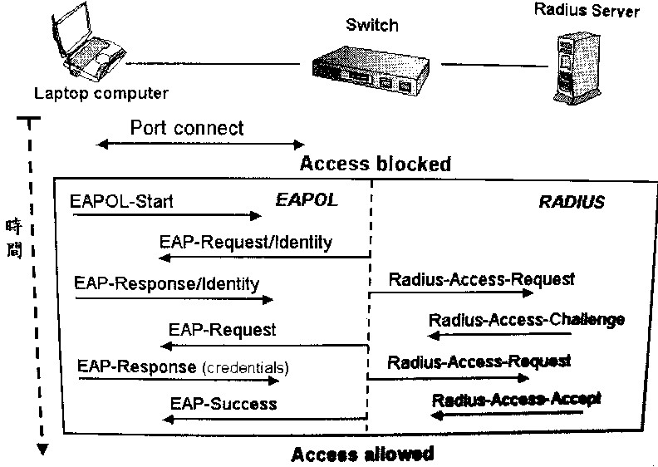
IEEE 802.1x Conversation
Notes:
Laptop 的 computer 可以向 switch 可以進行 port connect，接著開始進行 Request，先向 Switch 驗證之後向 Radius Server 做出要求，經過認證之後 Laptop 才可以進行傳輸。

Slide 108
HiperLan
ETSI
  European Telecommunications Standards Institute
Bran (Broadband Radio Access Network)
  HiperLan/1
  HiperLan/2
  HiperLink

Slide 109
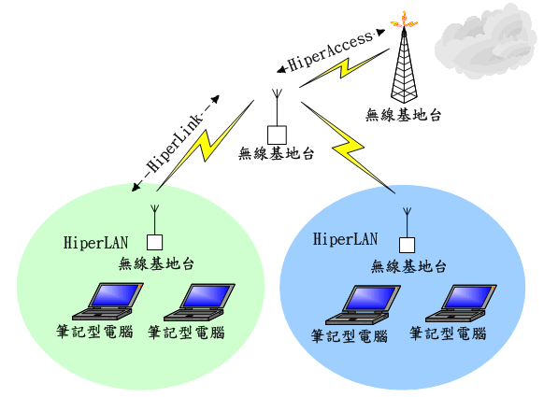
HiperLan Technology
Notes:
本張圖是一張 Hiperlan 技術的示意圖。
HiperAccess 提供一個遠距的無線連結到基地台，而無線基地台到 AP 間利用 HiperLink 提供無線網路的 backbone，而各區網內利用 HiperLan 的技術進行網路連結。

Slide 110
HiperLan/1
HiperLan = High Performance Radio Lan
High speed Wireless LAN
Modulation
  FSK：1.5 Mbps
  GMSK：23.5 Mbps
Spectrum：5 G
Transmission Rate：23.5 Mbps
Radius of Transmission Range：50 M

Slide 111
HiperLan/2
More high speed Wireless Lan
Spread Spectrum：OFDM
Spectrum：5 G
  2.4 G become more and more crowded
  5G has more bandwidth
Transmission Rate：54Mbps
Radius of Transmission Range：50 M

Slide 112
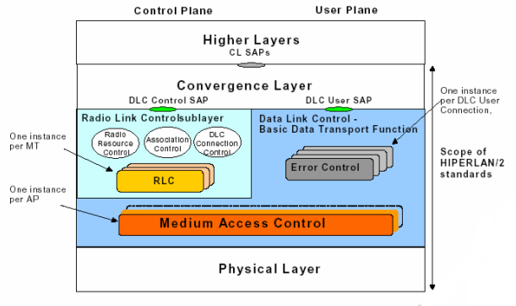
HiperLan/2 Protocol Stack
Notes:
HiperLan 主要包含了 Physical Layer, Mac Layer, Data Link Control, Radio Link Control 以及 Convergence Layer 這幾個 Layer。
而在負責控制 Radio Link 的部分還細分了 Radio Resource control, Association control, DLC Connection Control 三個元件，來控制有關於無線連結的事物。
而 Error control 包含在 Data Link Control 裡面，提供錯誤控制的機機制。

Slide 113
HiperLan/2 Standards
For corporate, public and home environments
Wireless access to the Internet and future multimedia
5GHz OFDM Physical Layer harmonized with IEEE 802.11a
Efficient and connection oriented DLC
  QoS (bandwidth reservation, collision avoidance)
  Robust to errors (ARQ, FEC)
  Enables real time video services at speeds of up to 54 Mbit/s.
provide interworking with several core networks
  Packet based convergence layer for Ethernet and IEEE 1394 networks
  Cell based convergence layer for ATM networks
Notes:
DLC: Data Link Control Layer

Slide 114
HiperLan/2 Physical Layer
OFDM
PHY burst
  Difference PHY bursts defined for different kinds of data
Radio transmitter
  19 channel, echo 20 MHz

Slide 115
HiperLan/2 Error Control
Acknowledged mode
  Selective repeat ARQ
  For user data
Repetition mode
  Reliable transmission by repeating data packets
  Option for broadcast data
Unacknowledged mode
  Unreliable, low latency
  For user data

Slide 116
HiperLan/2 Radio link control
Association Control
  Authentication, key management, encryption
  Association, disassociation
Radio Resource Control
  Dynamic frequency selection (DFS)
  Transmit power control
  Handover
DLC User Connection Control
  Setup and release of user connections, multicast and broadcast

Slide 117
HiperLan/2 Convergence Layer
Task:
  Adapt service requirements of different higher layers to the services offered by the DLC layer
Important functions:
  User data segmentation and reassembly
  Mapping of higher layer control plane procedures to procedures supported by the DLC layer (e.g. mobility management)
Convergence layers defined so far
  ATM
  Ethernet
  IEEE 1394

Slide 118
HiperLink
Indoor or outdoor
Part of backbone in wireless networks
Spectrum：17 G
Transmission Rate：155 Mbps
Radius of Transmission Range：150 M

Slide 119
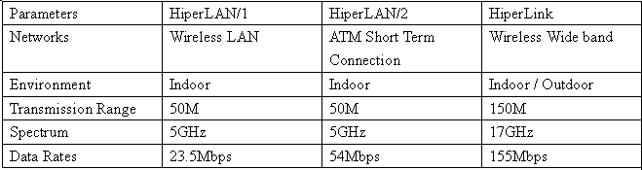
Comparison about HiperLan
Notes:
HiperLAN/2 是現在 HiperLAN 的主流，而 HiperLan 在 Wireless LAN 中作為無線網路 backbone 的工作。

Slide 120
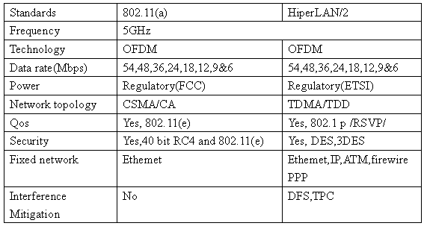
Comparison of IEEE 802.11a and HiperLan/2
Notes:
IEEE 802.11a 以及 HiperLan/2 是在網路上常常被提出來比較的兩種規格。
兩者皆使用了 5 GHz 的頻段，同時使用了 OFDM 的技術來作為傳輸。
最高的速度皆為 54Mbps ，同時都提供了 QoS 的機制以及 Security 的機制。
但是在上層所使用的網路來說，HiperLAN/2 的 Convergence Layer 可以提供除了 Ethernet 之外 ATM, PPP, IEEE 1394 等等的網路相容。

Slide 121
The end, Thanks you!

